Slide 1

Module 0
Matrix / Tensor Algebra
Notes:
Guidelines
Use section headers to chunk content in your presentation.
Use the same style of section header throughout your presentation.
Keep your title to no more than 2 lines.

Slide 2
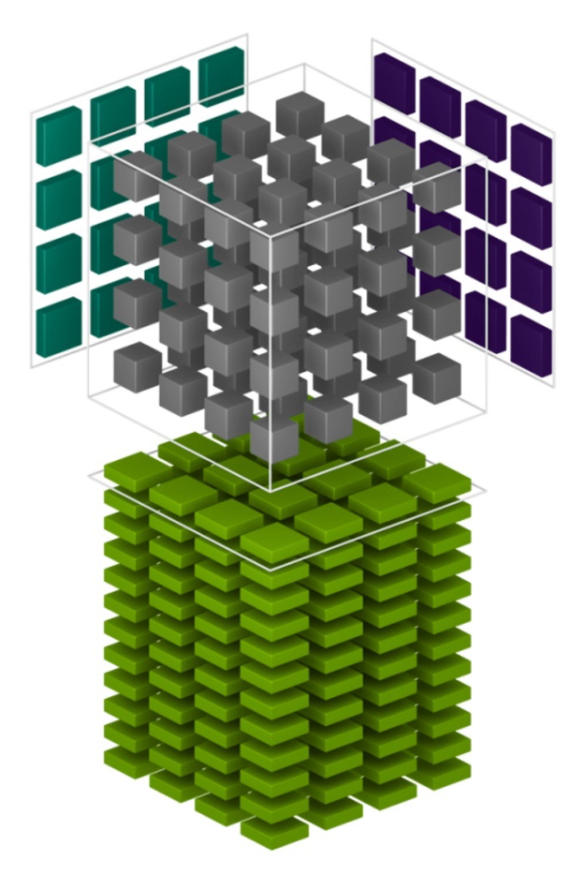
Matrices / Tensors
Notes:
Guidelines
Use a title slide at the beginning of your presentation. There are 9 variations of title slides to choose from.
If you will have a series of slideshows, we recommend using the same style of title slide for each presentation.
Keep your title to no more than 2 lines.
Do not change the font style or font size of the title or subtitle.

Slide 3
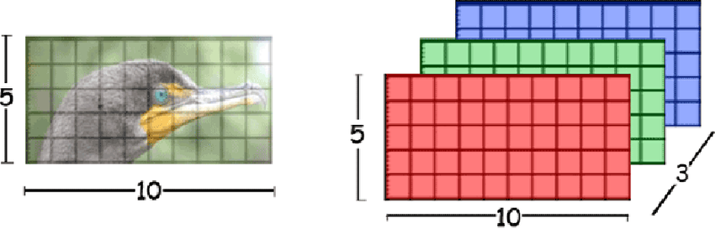
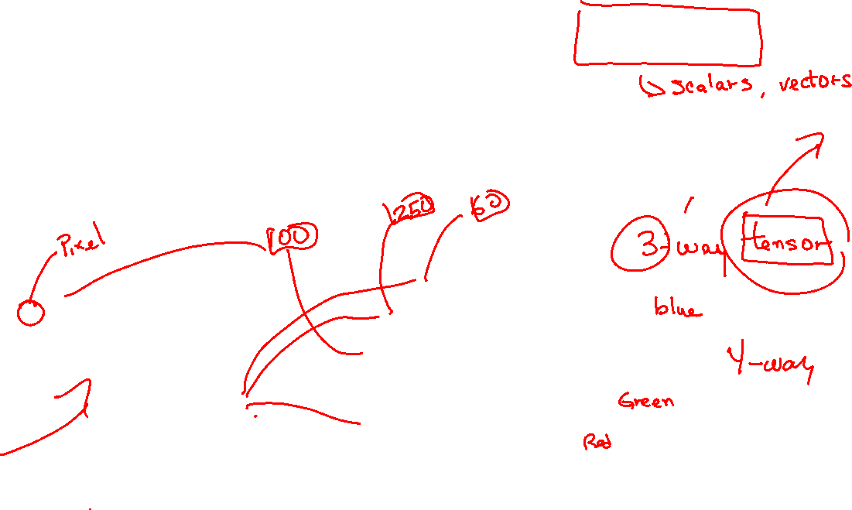
Data Vectors, Matrices, Tensors
Feature creation in ML involve transforming raw data into numerical representations (vectors, matrices, tensors)
For example, Images

Slide 4
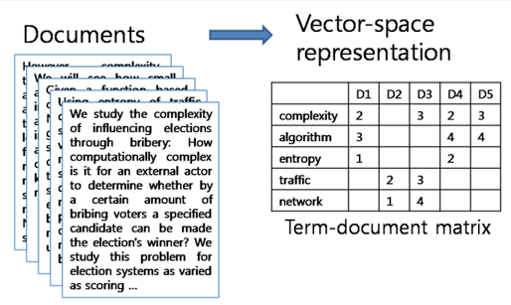
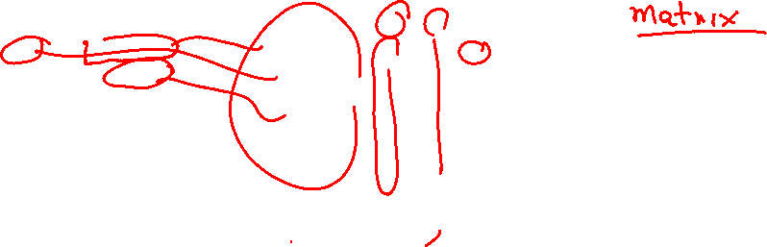
Data Vectors, Matrices, Tensors
Text, Documents

Slide 5
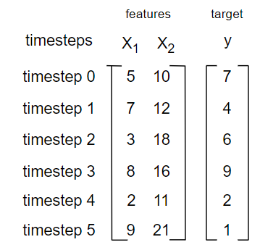
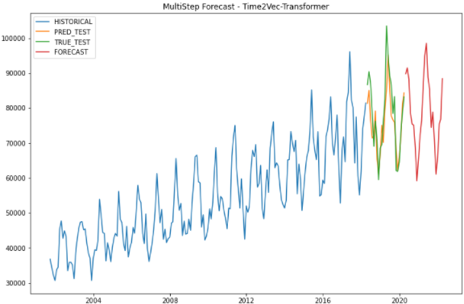
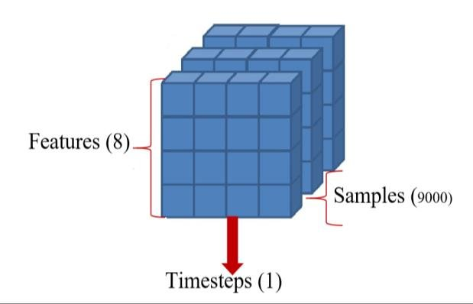
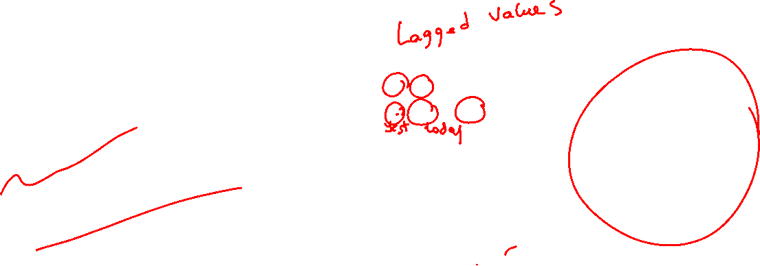
Data Vectors, Matrices, Tensors
Time Series

Slide 6
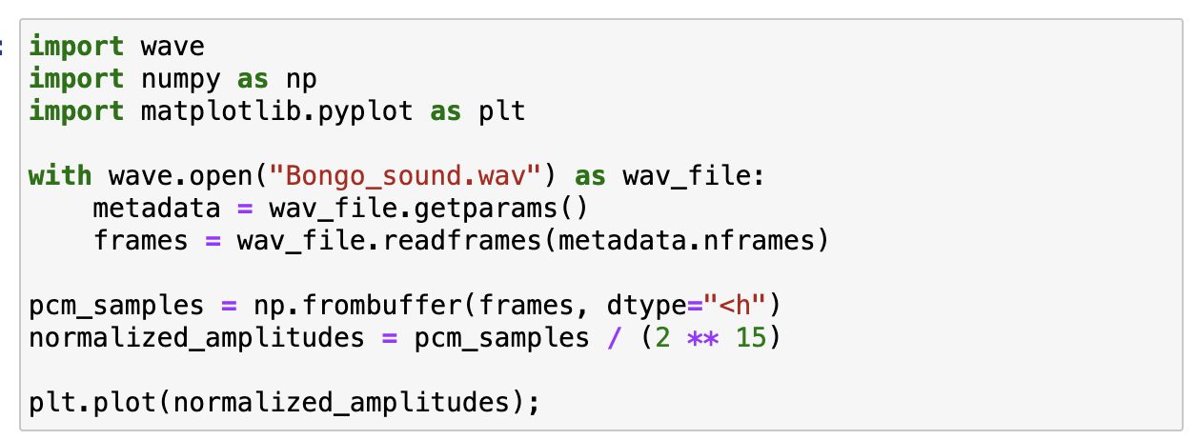
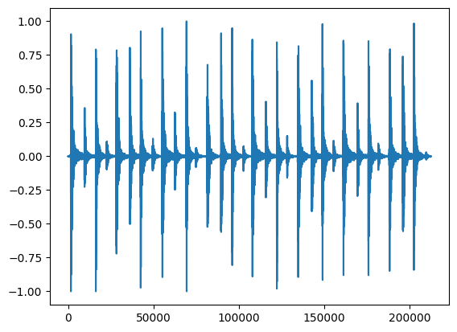
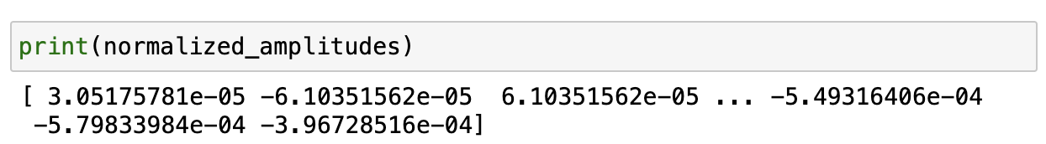
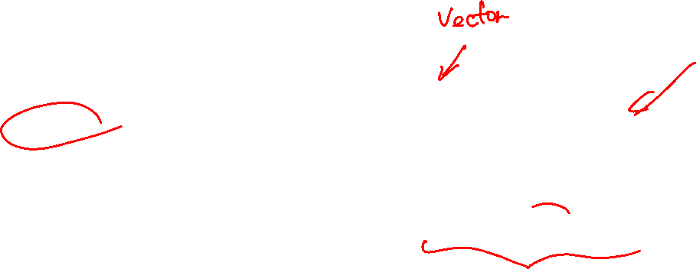
Data Vectors, Matrices, Tensors
Audio

Slide 7
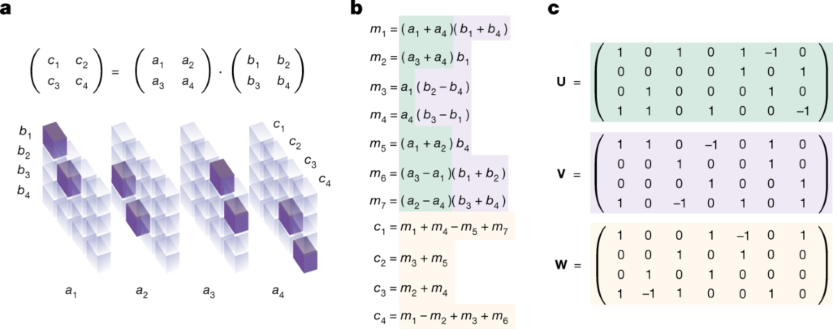
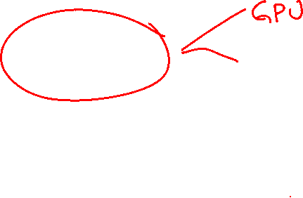
Data Vectors, Matrices, Tensors
Neural Net Weights

Slide 8


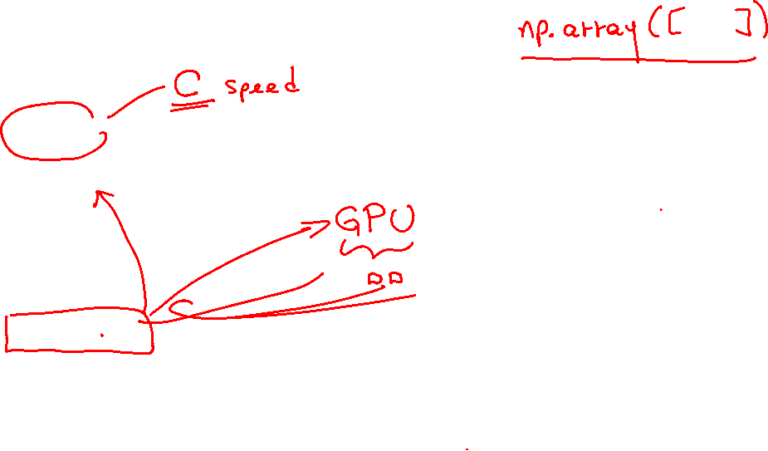
NumPy vs Tensorflow
NumPy provides support for large multidimensional arrays (vectors), matrices and tensors.
Tensorflow also provides support for large multidimensional arrays (vectors), matrices and tensors. Has the ability to deploy numerical manipulations to run on CPUs, GPUs.

Slide 9
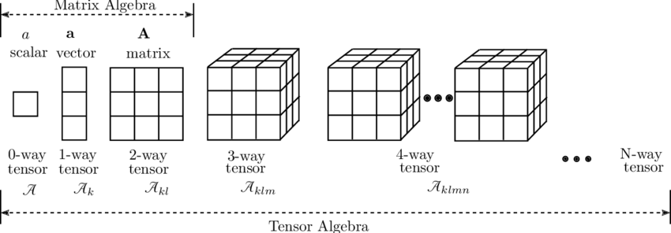
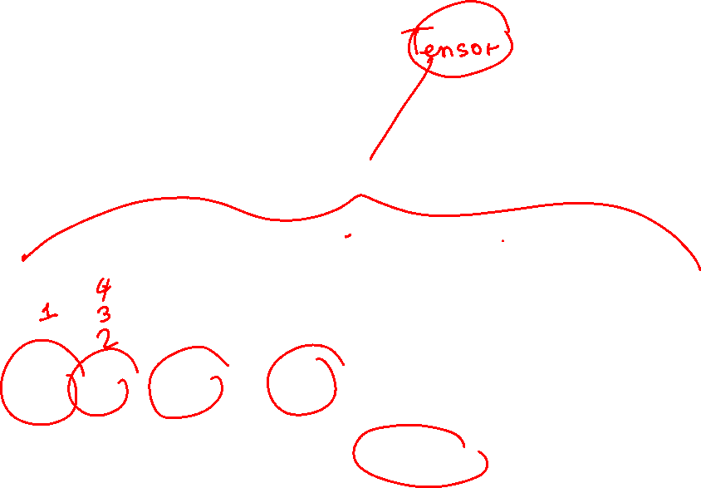
Linear Algebra
study of vectors / multidimensional arrays and certain algebra rules to manipulate them.

Slide 10
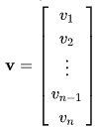
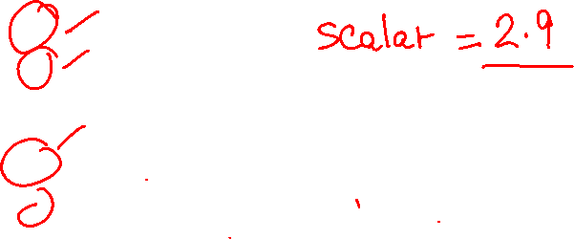
Vectors
A vector is an object that has both a magnitude and a direction. In mathematics and physics, vector is a term that refers to some quantities that cannot be expressed by a single number (a scalar).

Slide 11

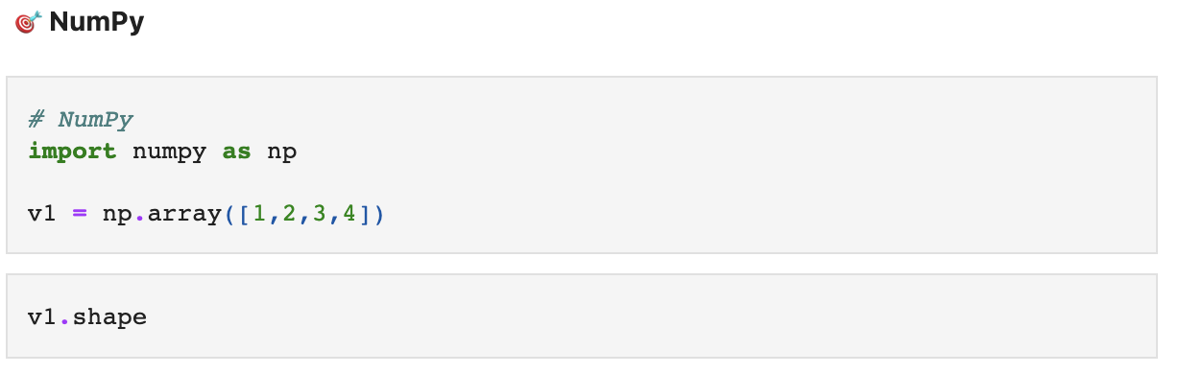

Vectors
A vector is an object that has both a magnitude and a direction. In mathematics and physics, vector is a term that refers to some quantities that cannot be expressed by a single number (a scalar).

Slide 12
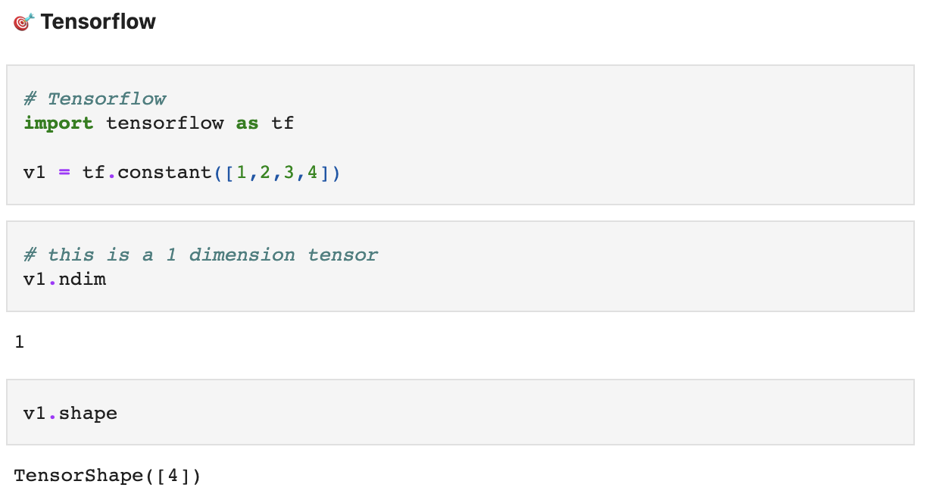

Vectors
A vector is an object that has both a magnitude and a direction. In mathematics and physics, vector is a term that refers to some quantities that cannot be expressed by a single number (a scalar).

Slide 13
Python
Notes:
Guidelines
Use a title slide at the beginning of your presentation. There are 9 variations of title slides to choose from.
If you will have a series of slideshows, we recommend using the same style of title slide for each presentation.
Keep your title to no more than 2 lines.
Do not change the font style or font size of the title or subtitle.

Slide 14
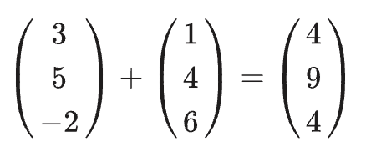
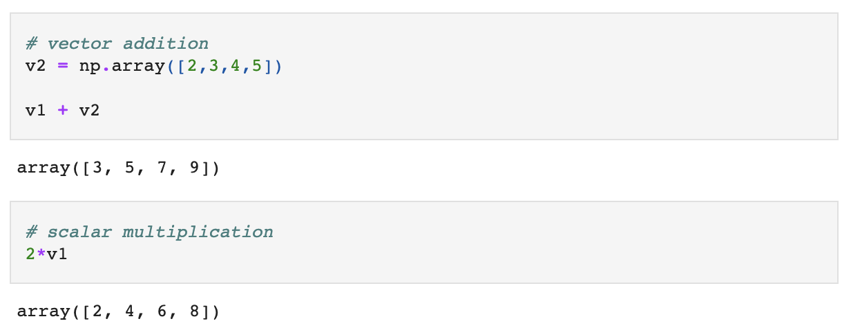
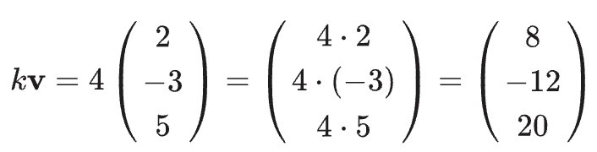
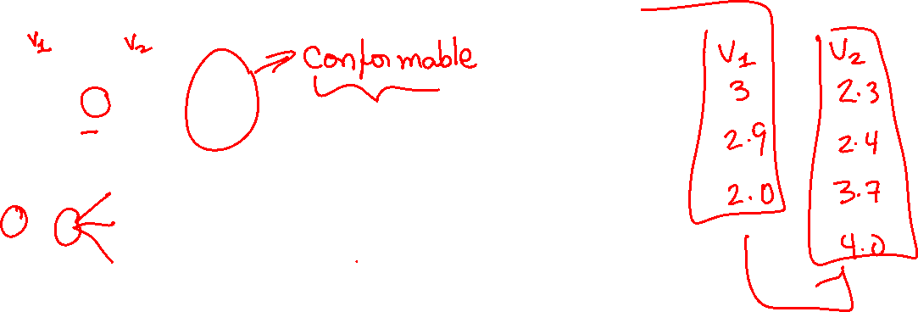
Vector Operations (+,-, scalar mult)
Adding vectors means adding the individual elements.
Multiplying vectors by scalars means multiplying each element by scalar

Slide 15

Vectors
Adding vectors means adding the individual elements.
Multiplying vectors by scalars means multiplying each element by scalar

Slide 16
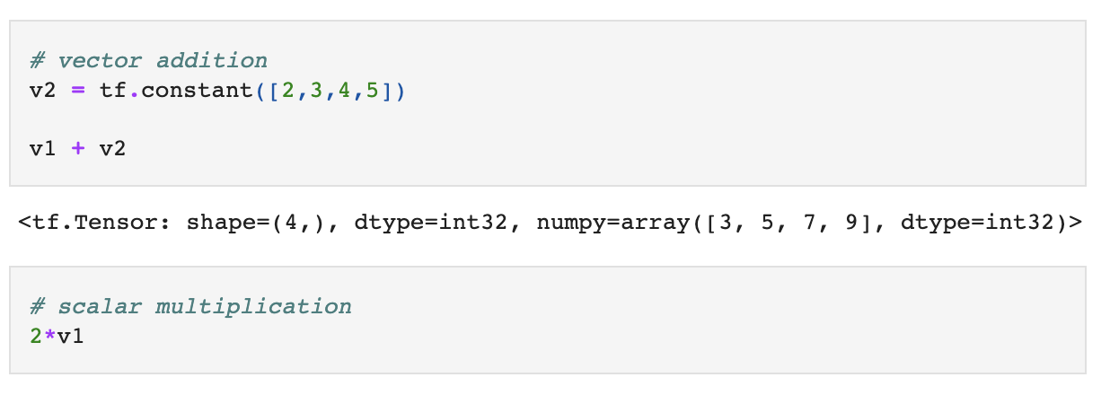

Vectors
Adding vectors means adding the individual elements.
Multiplying vectors by scalars means multiplying each element by scalar

Slide 17
Python
Notes:
Guidelines
Use a title slide at the beginning of your presentation. There are 9 variations of title slides to choose from.
If you will have a series of slideshows, we recommend using the same style of title slide for each presentation.
Keep your title to no more than 2 lines.
Do not change the font style or font size of the title or subtitle.

Slide 18
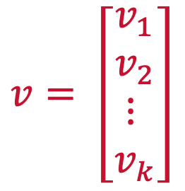
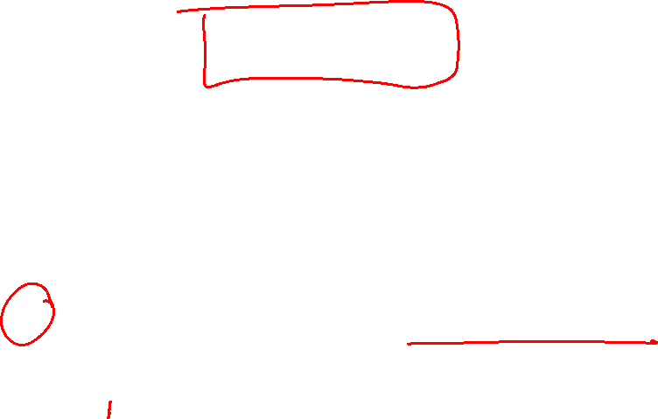
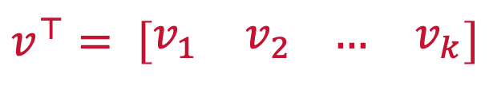
Vectors Transpose
The transpose of a vector changes a column vector to a row vector or vice versa.
$$v= \left[\begin{matrix}v_{1} \\ v_{2} \\ ⋮ \\ v_{k}\end{matrix}\right]$$
$$v^{⊤}= \left[\begin{matrix}v_{1} & v_{2} \end{matrix}\begin{matrix}… & v_{k}\end{matrix}\right]$$

Slide 19
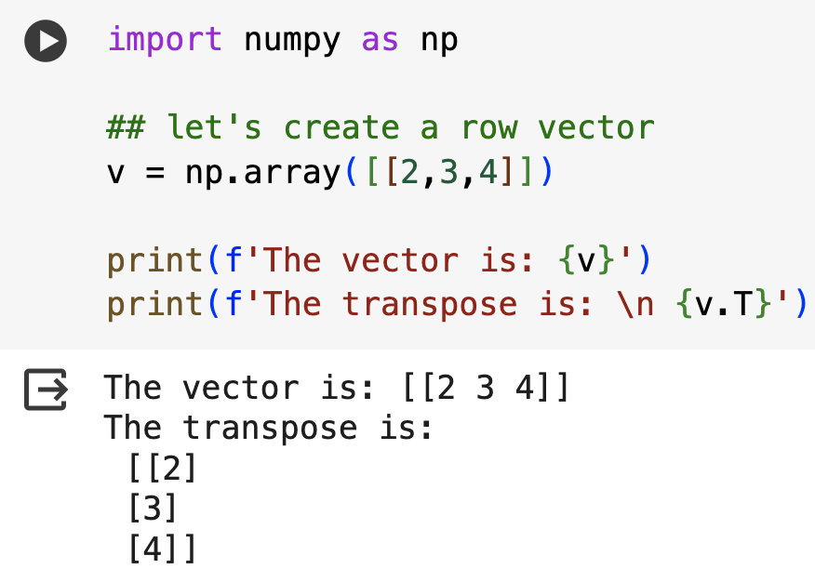
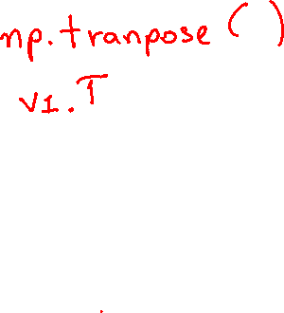
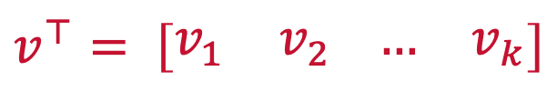
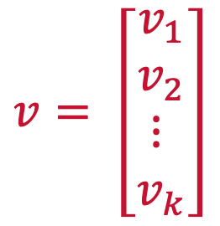
Vectors
The transpose of a vector changes a column vector to a row vector or vice versa.
$$v= \left[\begin{matrix}v_{1} \\ v_{2} \\ ⋮ \\ v_{k}\end{matrix}\right]$$
$$v^{⊤}= \left[\begin{matrix}v_{1} & v_{2} \end{matrix}\begin{matrix}… & v_{k}\end{matrix}\right]$$

Slide 20
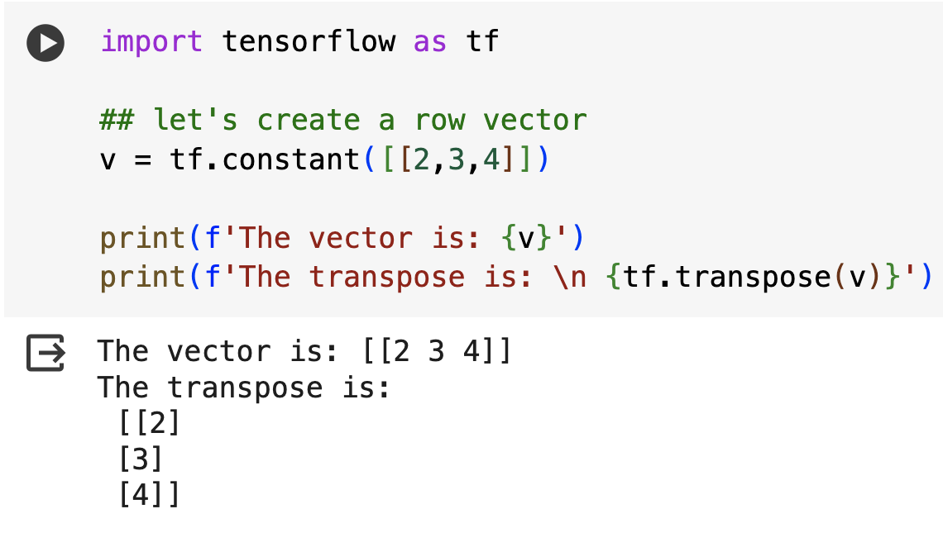

Vectors
The transpose of a vector changes a column vector to a row vector or vice versa.
$$v= \left[\begin{matrix}v_{1} \\ v_{2} \\ ⋮ \\ v_{k}\end{matrix}\right]$$
$$v^{⊤}= \left[\begin{matrix}v_{1} & v_{2} \end{matrix}\begin{matrix}… & v_{k}\end{matrix}\right]$$

Slide 21
Python
Notes:
Guidelines
Use a title slide at the beginning of your presentation. There are 9 variations of title slides to choose from.
If you will have a series of slideshows, we recommend using the same style of title slide for each presentation.
Keep your title to no more than 2 lines.
Do not change the font style or font size of the title or subtitle.

Slide 22
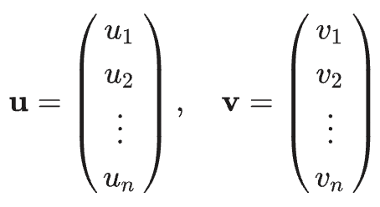
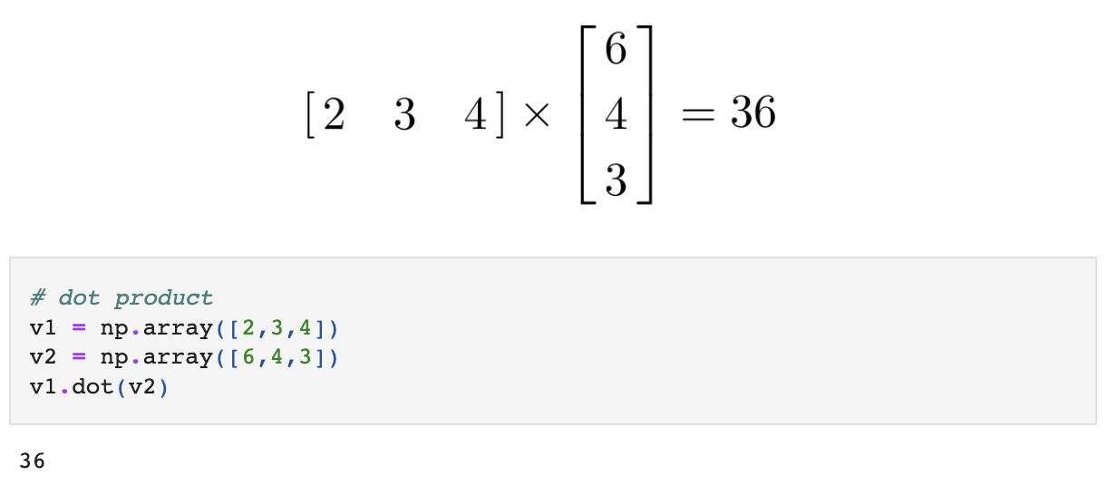
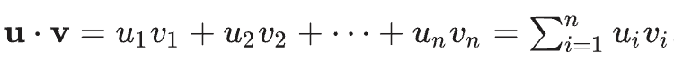
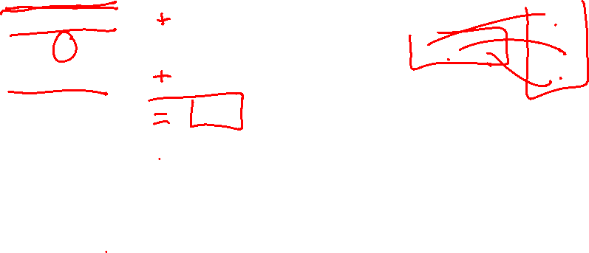
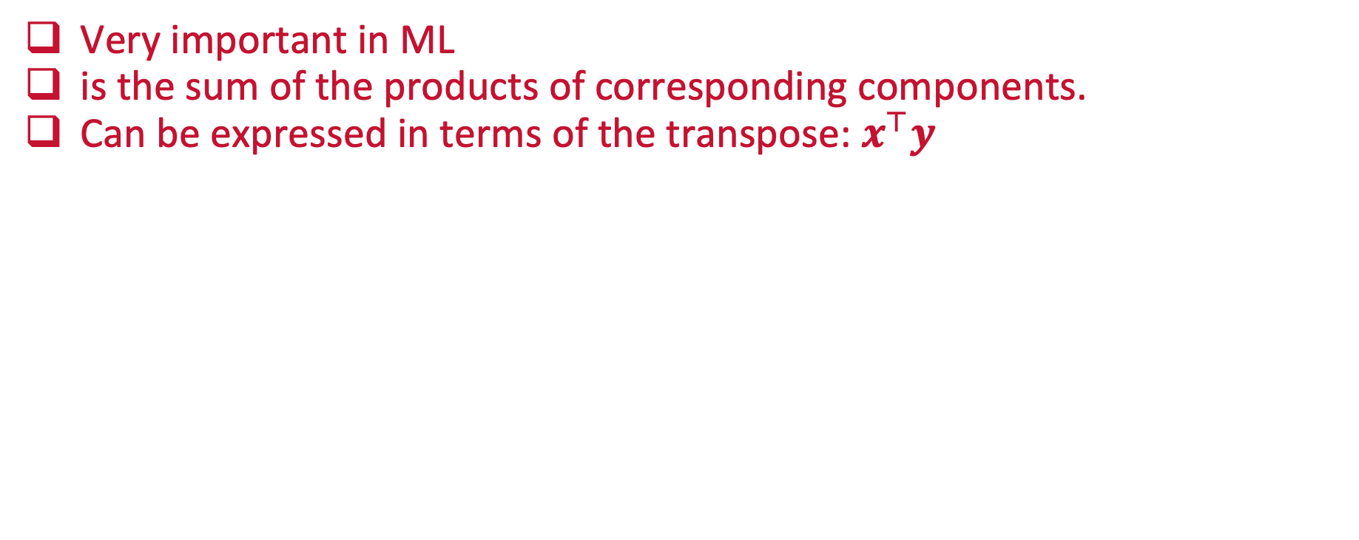
The Dot Product
Very important in ML
is the sum of the products of corresponding components.
Can be expressed in terms of the transpose: $x^{⊤}y$

Slide 23
The Dot Product
Very important in ML
is the sum of the products of corresponding components.
Can be expressed in terms of the transpose: $x^{⊤}y$

Slide 24
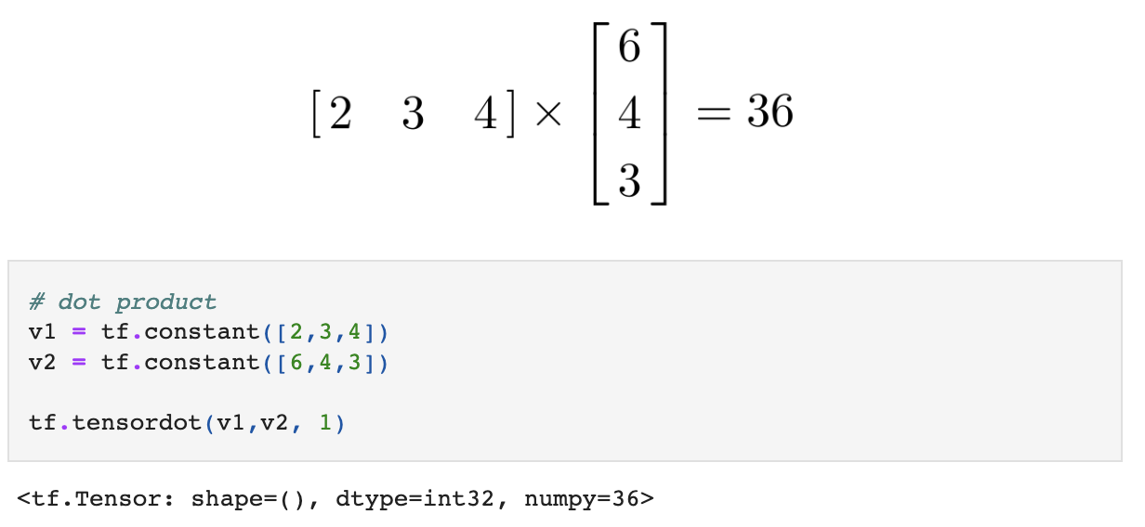
The Dot Product
Very important in ML
is the sum of the products of corresponding components.

Slide 25
Python
Notes:
Guidelines
Use a title slide at the beginning of your presentation. There are 9 variations of title slides to choose from.
If you will have a series of slideshows, we recommend using the same style of title slide for each presentation.
Keep your title to no more than 2 lines.
Do not change the font style or font size of the title or subtitle.

Slide 26
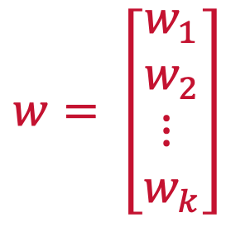
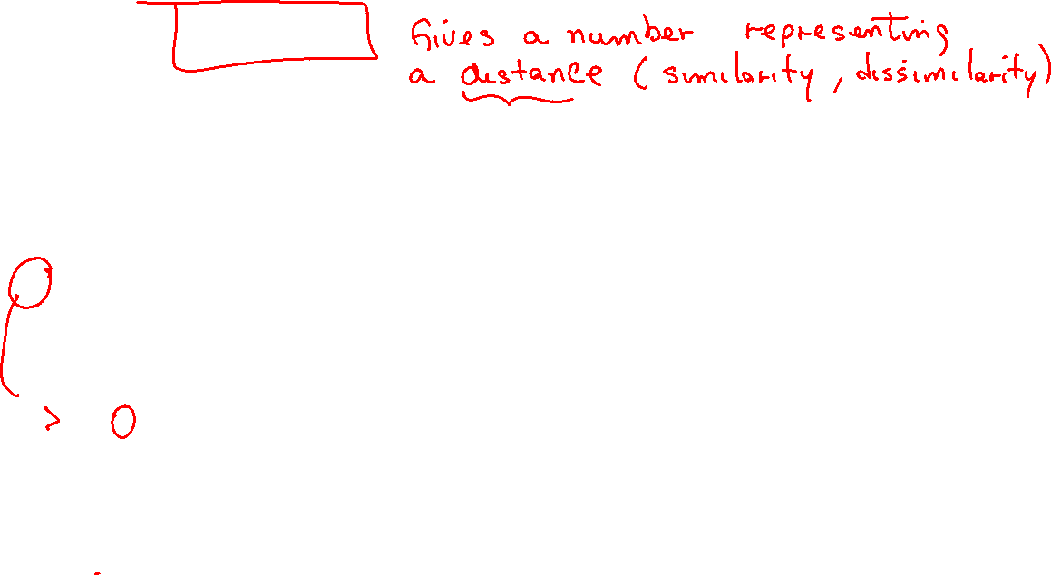
Vector Norms
Used in ML to regularize (drop insignificant relationships) weights.
$$w= \left[\begin{matrix}w_{1} \\ w_{2} \\ ⋮ \\ w_{k}\end{matrix}\right]$$
Goal is to zero out or diminish weights for insignificant variables

Slide 27
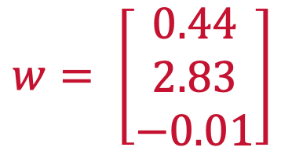
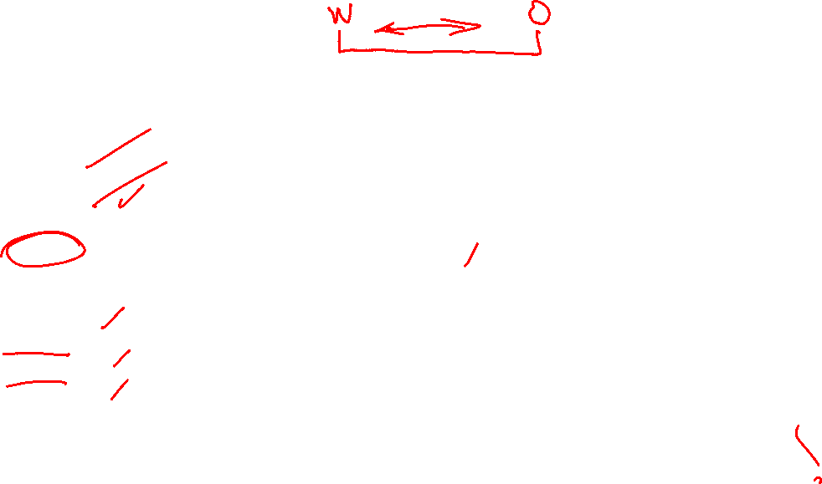
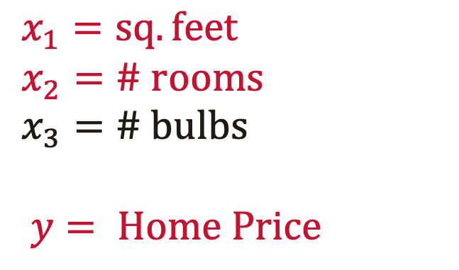
Vector Norms
Used in ML to regularize (drop insignificant relationships) weights.
$$w= \left[\begin{matrix}0.44 \\ 2.83 \\ −0.01\end{matrix}\right]$$
$$x_{1}=sq. feet$$
$$x_{2}=\# rooms$$
$$x_{3}=\# bulbs$$
$$y= Home Price$$
We want this weight to be 0 or as close to zero as possible

Slide 28
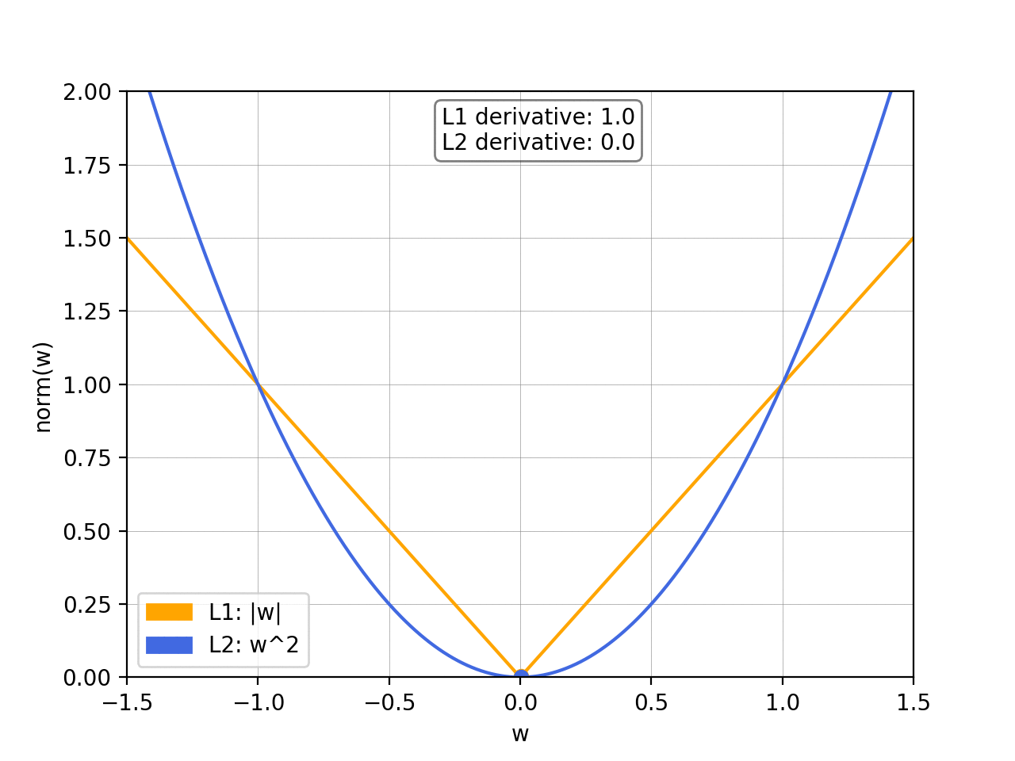
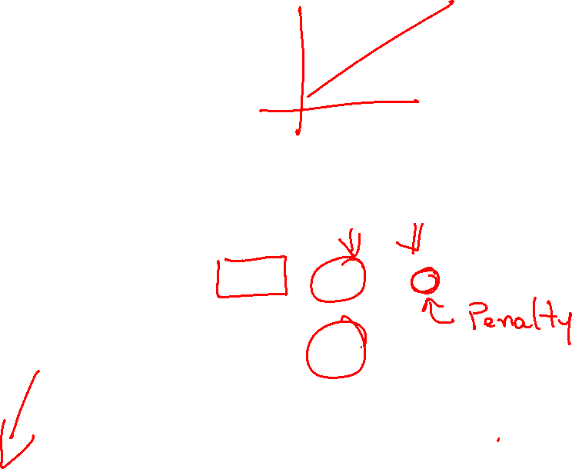
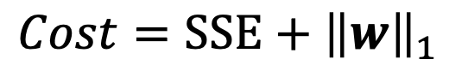
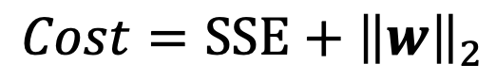
Vector Norms
Are added to cost functions as penalties (e.g., SSE, MSE)
The L₁ norm (tends to zero out the unimportant weights).
The L₂ norm (tends to to get the weights to be close to zero).
$$Cost=SSE+{\left\|w\right\|}_{2}$$
$$Cost=SSE+{\left\|w\right\|}_{1}$$

Slide 29




L₂ Norm
Tends to make weights close to zero
For a weight vector:
The L2 norm is defined as:
$$w= \left[\begin{matrix}w_{1} \\ w_{2} \\ ⋮ \\ w_{k}\end{matrix}\right]$$
$${\left\|w\right\|}_{2}=\sqrt{\sum_{i=1}^{k}{w_{i}^{2}}}$$
$${\left\|w\right\|}_{2}=\sqrt{w^{⊤}w}$$

Slide 30



L₂ Norm
$$w= \left[\begin{matrix}0.44 \\ 2.83 \\ −0.01\end{matrix}\right]$$
$${\left\|w\right\|}_{2}=\sqrt{w^{⊤}w}$$

Slide 31

L₂ Norm
$$w= \left[\begin{matrix}0.44 \\ 2.83 \\ −0.01\end{matrix}\right]$$
$${\left\|w\right\|}_{2}=\sqrt{w^{⊤}w}$$

Slide 32


L₁ Norm
Tends to make weights zero
For a weight vector:
The L1 norm is defined as:
$$w= \left[\begin{matrix}w_{1} \\ w_{2} \\ ⋮ \\ w_{k}\end{matrix}\right]$$
$${\left\|w\right\|}_{1}=\sum_{i=1}^{k}{\left|w_{i}\right|}$$

Slide 33


L₁ Norm
$$w= \left[\begin{matrix}0.44 \\ 2.83 \\ −0.01\end{matrix}\right]$$
$${\left\|w\right\|}_{1}=\sum_{i=1}^{k}{\left|w_{i}\right|}$$

Slide 34

L₁ Norm
$$w= \left[\begin{matrix}0.44 \\ 2.83 \\ −0.01\end{matrix}\right]$$
$${\left\|w\right\|}_{1}=\sum_{i=1}^{k}{\left|w_{i}\right|}$$

Slide 35





Vector Norms
Are added to cost functions as penalties (e.g., SSE, MSE)
The L₁ norm (tends to zero out the unimportant weights).
The L₂ norm (tends to to get the weights to be close to zero).
$$Cost=SSE+λ{\left\|w\right\|}_{2}$$
$$Cost=SSE+λ{\left\|w\right\|}_{1}$$
$λ$ is used to control amount of penalty

Slide 36


Slide 37


Slide 38
Python
Notes:
Guidelines
Use a title slide at the beginning of your presentation. There are 9 variations of title slides to choose from.
If you will have a series of slideshows, we recommend using the same style of title slide for each presentation.
Keep your title to no more than 2 lines.
Do not change the font style or font size of the title or subtitle.

Slide 39


Matrices
A matrix is a rectangular array of numbers (called elements) arranged into rows and columns.

Slide 40



Matrices
A matrix is a rectangular array of numbers (called elements) arranged into rows and columns.

Slide 41


Matrices
A matrix is a rectangular array of numbers (called elements) arranged into rows and columns.

Slide 42


Matrix Addition / Subtraction
You can add two matrices, if they have the same dimensions.

Slide 43

Matrix Addition / Subtraction
You can add two matrices if they have the same dimensions

Slide 44


Matrix Addition / Subtraction
You can add two matrices ifthey have the same dimensions

Slide 45
Python
Notes:
Guidelines
Use a title slide at the beginning of your presentation. There are 9 variations of title slides to choose from.
If you will have a series of slideshows, we recommend using the same style of title slide for each presentation.
Keep your title to no more than 2 lines.
Do not change the font style or font size of the title or subtitle.

Slide 46


Matrix Multiplication
A matrix can be multiplied by any other matrix that has the same number of rows as the first has columns (conformable).
In other words, Inner Dimensions must match

Slide 47


Matrix Multiplication
A matrix can be multiplied by any other matrix that has the same number of rows as the first has columns (conformable).
In other words, Inner Dimensions must match
Resulting matrix have outer dimensions

Slide 48

Matrix Multiplication
A matrix can be multiplied by any other matrix that has the same number of rows as the first has columns (conformable).
In other words, Inner Dimensions must match
Resulting matrix have outer dimensions

Slide 49

Matrix Multiplication

Slide 50

Matrix Multiplication

Slide 51
Python
Notes:
Guidelines
Use a title slide at the beginning of your presentation. There are 9 variations of title slides to choose from.
If you will have a series of slideshows, we recommend using the same style of title slide for each presentation.
Keep your title to no more than 2 lines.
Do not change the font style or font size of the title or subtitle.

Slide 52


Matrix Transpose
Is a matrix that is obtained by interchanging the rows and columns of the matrix

Slide 53

Matrix Transpose

Slide 54

Matrix Transpose

Slide 55
Python
Notes:
Guidelines
Use a title slide at the beginning of your presentation. There are 9 variations of title slides to choose from.
If you will have a series of slideshows, we recommend using the same style of title slide for each presentation.
Keep your title to no more than 2 lines.
Do not change the font style or font size of the title or subtitle.

Slide 56



Identity Matrix
Is a matrix of order $n×n$ such that each main diagonal element is equal to 1

Slide 57



Identity Matrix
Matrix of order $n×n$ such that each main diagonal element is equal to 1

Slide 58

Identity Matrix
Matrix of order $n×n$ such that each main diagonal element is equal to 1

Slide 59
Python
Notes:
Guidelines
Use a title slide at the beginning of your presentation. There are 9 variations of title slides to choose from.
If you will have a series of slideshows, we recommend using the same style of title slide for each presentation.
Keep your title to no more than 2 lines.
Do not change the font style or font size of the title or subtitle.

Slide 60


Linear Dependence
A matrix is linearly dependent if at least one row (or one column) is a linear combination of the others

Slide 61

Linear Dependence
A matrix is linearly dependent if at least one row (or one column) is a linear combination of the others
2 X

Slide 62

Linear Dependence
The rank of a matrix is the number of columns that are independent
2 X

Slide 63

Linear Dependence

Slide 64

Linear Dependence

Slide 65
Python
Notes:
Guidelines
Use a title slide at the beginning of your presentation. There are 9 variations of title slides to choose from.
If you will have a series of slideshows, we recommend using the same style of title slide for each presentation.
Keep your title to no more than 2 lines.
Do not change the font style or font size of the title or subtitle.

Slide 66




Matrix Inverse
is a matrix $A^{−1}$ such that ${AA}^{−1}=I,$where I is the identity matrix.

Slide 67

Matrix Inverse

Slide 68

Matrix Inverse

Slide 69
Python
Notes:
Guidelines
Use a title slide at the beginning of your presentation. There are 9 variations of title slides to choose from.
If you will have a series of slideshows, we recommend using the same style of title slide for each presentation.
Keep your title to no more than 2 lines.
Do not change the font style or font size of the title or subtitle.

Slide 70


Sparse vs Dense Matrices
a sparse matrix is a matrix in which most of the elements are zero

Slide 71

Sparse vs Dense Matrices

Slide 72

Sparse vs Dense Matrices

Slide 73
Python
Notes:
Guidelines
Use a title slide at the beginning of your presentation. There are 9 variations of title slides to choose from.
If you will have a series of slideshows, we recommend using the same style of title slide for each presentation.
Keep your title to no more than 2 lines.
Do not change the font style or font size of the title or subtitle.

Slide 74


Tensors
A Tensor is a generalization of Vectors and Matrices to higher dimensions

Slide 75


Tensors

Slide 76

Tensors

Slide 77
Python
Notes:
Guidelines
Use a title slide at the beginning of your presentation. There are 9 variations of title slides to choose from.
If you will have a series of slideshows, we recommend using the same style of title slide for each presentation.
Keep your title to no more than 2 lines.
Do not change the font style or font size of the title or subtitle.

